Slide 1


Kubernetes 1
Angel Sevilla Camins

Slide 2


planning
Recap Docker
Container Automation & Orchestration
What is Kubernetes
Kubernetes components
Lab:
Using Kubernetes
Install k8s
ex1: Flask-demo
ex2: message-app

Slide 3
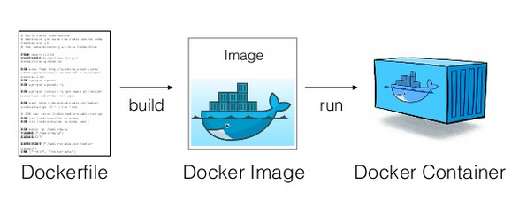
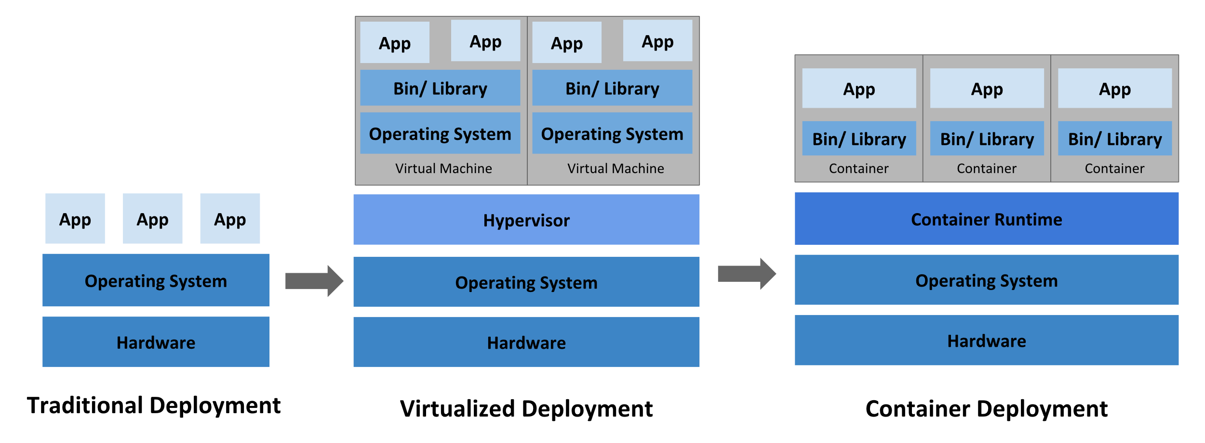
1. Recap Docker

Slide 4
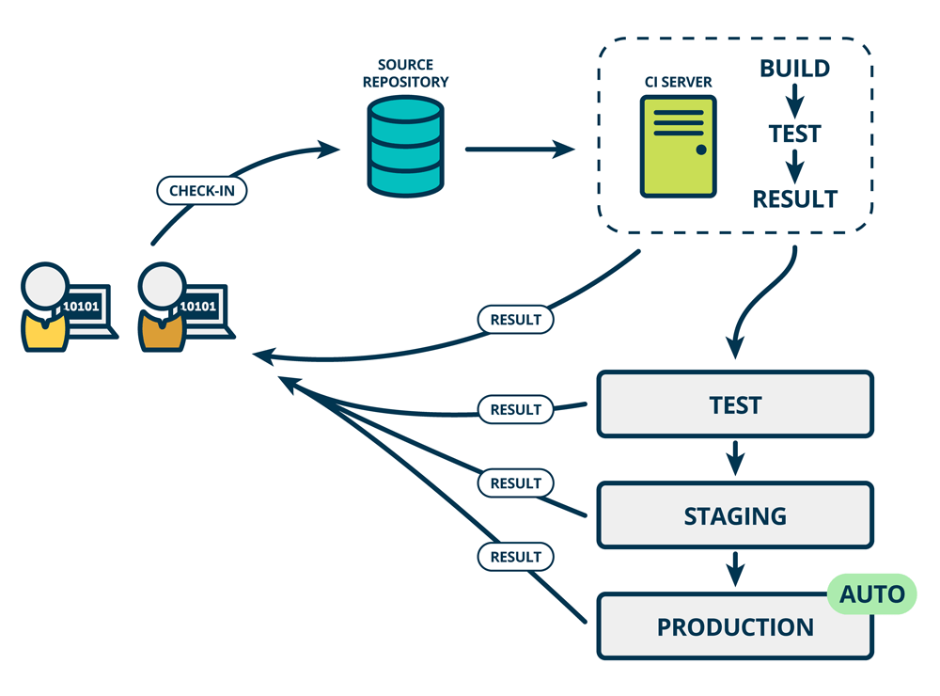
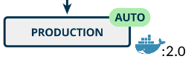
2. COntainer AUTOMation

Slide 5
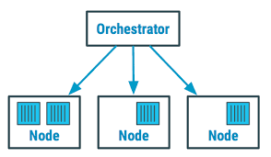
2. Container orchestration
How do we automate container lifecycle?
How can we easily scale out/in/up/down?
How can we ensure our containers are re-created if they fail?
How can we replace containers without downtime (blue/green deploy)?
How can we control/track where containers get started?
How can we create cross-node virtual networks?
How can we ensure only trusted servers run our containers?
How can we store secrets, keys, passwords and get them to the right container (and only that container)?
How can we manage container dependencies:
Volumes
Connectivity with other containers
Hardware requirements
Run schedule

Slide 6
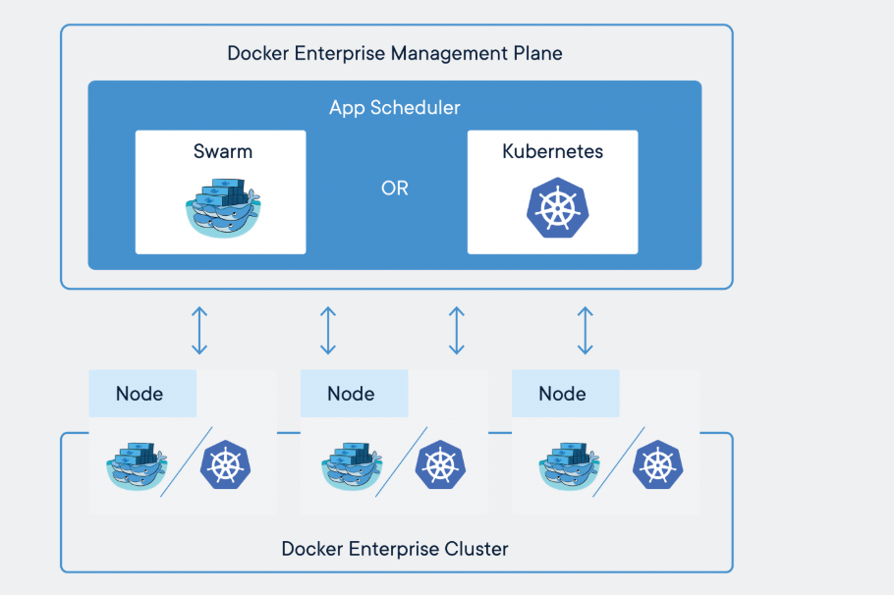
2. Container orchestration
Ecosystem for containers
Multiple hosts
VM's, physical servers
Local image registry/management
Automated deployments
Rolling upgrades
Scheduling
Load balancing
Healthy checks

Slide 7
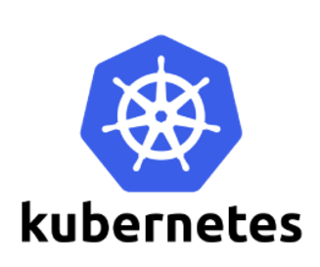
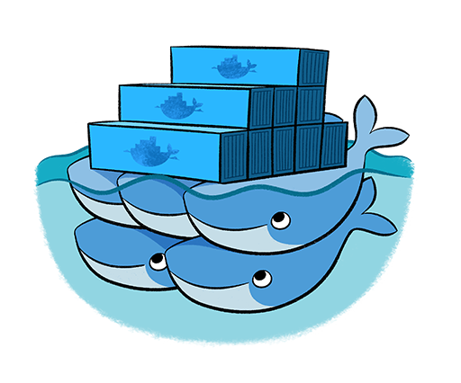
2. Container orchestration Kubernetes vs. docker swarm
Kubernetes
Widest cloud support
Widest community adoption
Very flexible – works for virtually any use case
Checkbox item for most companies/clients
Docker Swarm
Easiest orchestrator to manage
Light-weight (integrated in Docker)
80/20 rule for use cases
Runs everywhere where Docker does
Security by default (“batteries included but removable”)

Slide 8
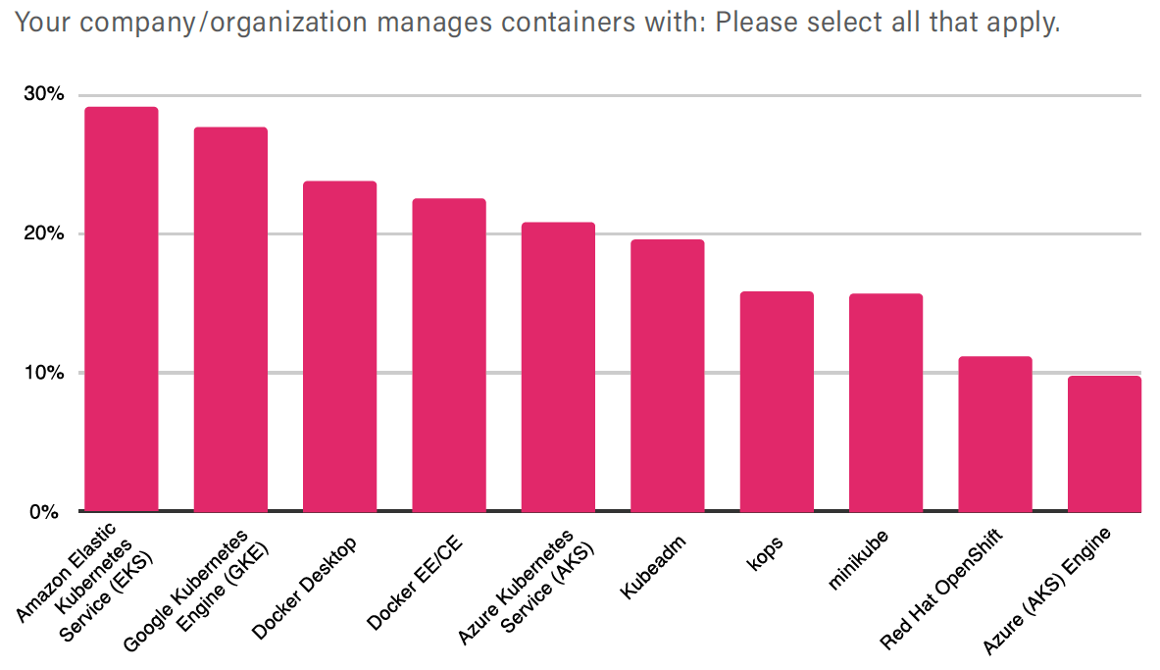
2. Container orchestration Key takeaways from cncf survey 2019
“… there are more than 109 tools to manage containers, but 89% are using different forms of Kubernetes.“

Slide 9
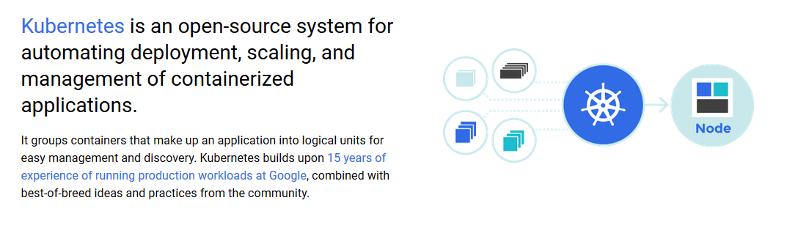
3. Kubernetes

Slide 10
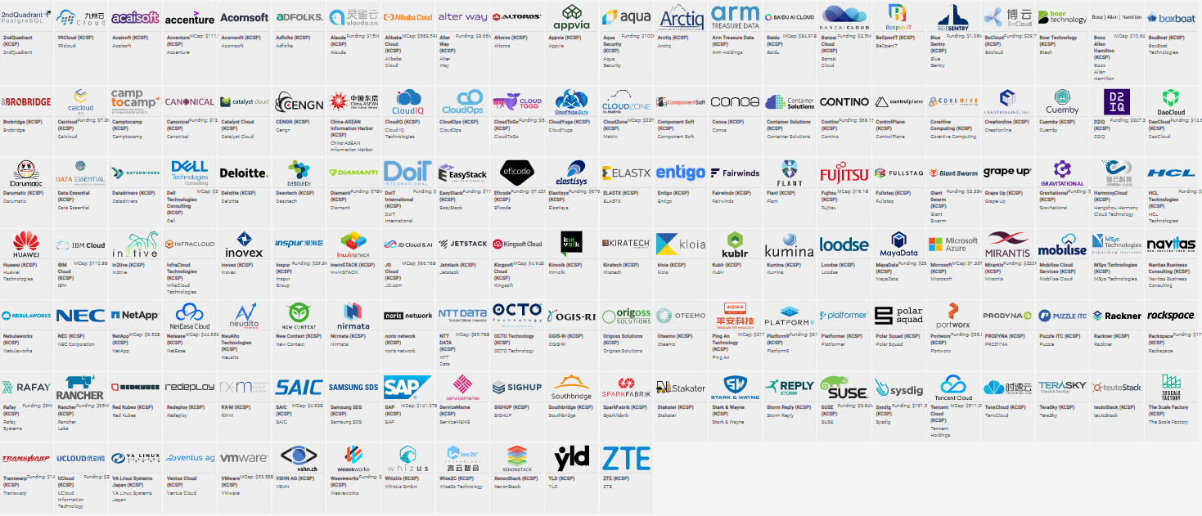
3. Kubernetes certified distributions, hosts, installers

Slide 11
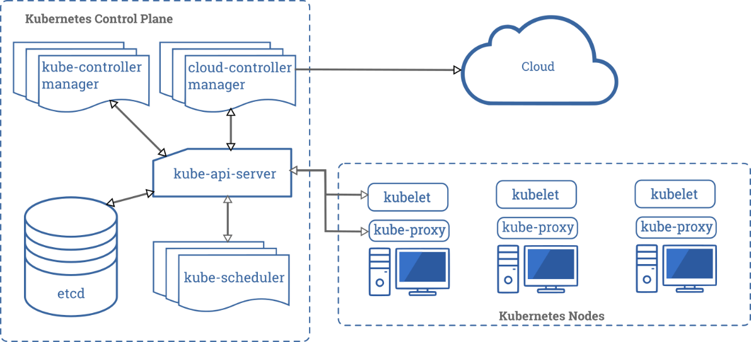
3. Kubernetes
Container organization
Find a good match between container requirements and available resources
Organize containers in groups for better modularity
Auto scaling
Replicate containers based on demand
Traffic routing and load balancing
Easy discovery of other containers
Automatic responses to outages or high traffic
Configuration management
Store and manage sensitive information
Uncouple containers from configs
“Infrastructure as code”

Slide 12
3. Kubernetes architecture
master1
master2
master3
etcd
API
Control Panel
Scheduler
Controller Manager
CoreDNS
Docker runtime
node1
node2
node3
node...
nodeN
Kubelet
Kube-proxy
Docker runtime

Slide 13
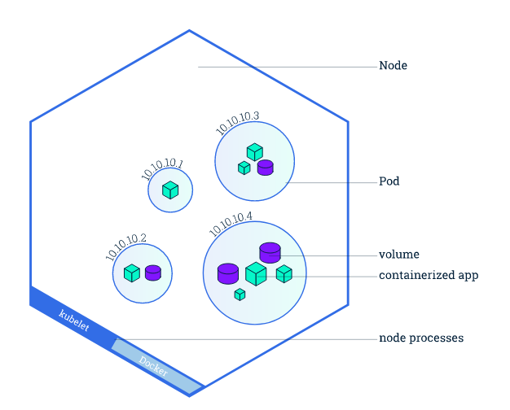
4. Kubernetes Components Nodes
Worker machine in a cluster
Can be a VM or a physical computer
“runs things”
Managed by the master
Contains a container runtime
Contains components to start and access pods

Slide 14
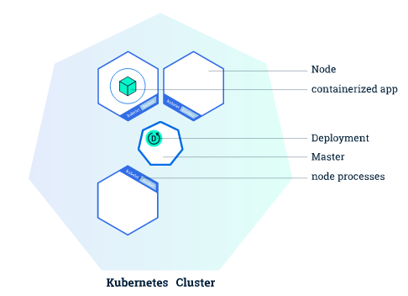
4. Kubernetes Components
Pod: basic unit of deployment
Controller: creating/updating pods and other objects:
Deployment, ReplicaSet, StatefullSet, Job, etc.
Service: network endpoint to connect to pod
Namespace: to group objects in cluster

Slide 15
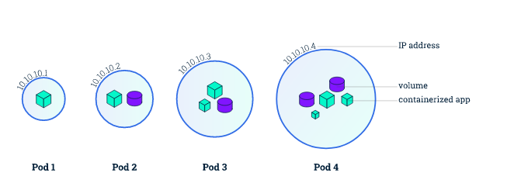
4. Kubernetes Components Pods
Atomic units of the Kubernetes platform
A group of one or more containers
Tightly coupled
Shared resources
A specification how to run the containers
Images and image versions
One logical host
Shared IP address
Shared port space
Contents are co-located and co-scheduled

Slide 16
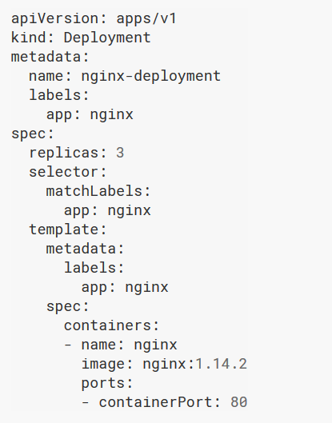
4. Kubernetes Components Deployments
Responsible for creating and updating instances of an application
Instances = pods
Deployment manages creation of pods
Specify desired state in configuration
Pods
Number of replications
Pod update strategies
Pod resources
CPU / memory
Volumes
If state diverts from desired state Kubernetes tries to repair it (i.e. restart failing pods)

Slide 17
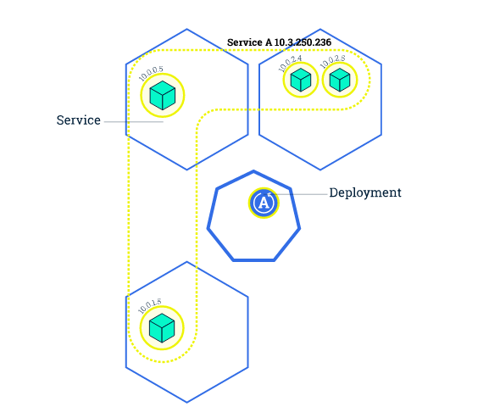
4. Kubernetes Components Services
Front-end and load balancer for pods
Provides fixed access point to pods that power the service
Maintains stable interface over changes on the pod level

Slide 18
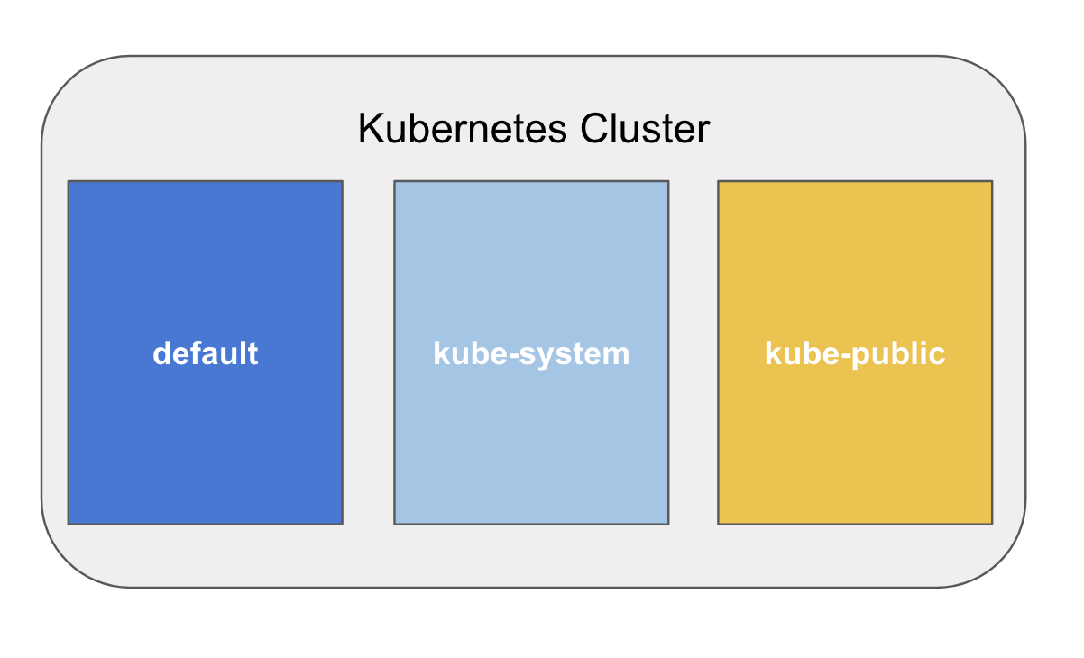
4. Kubernetes Components NAMESPACES
Namespaces provide a scope for names.
Names of resources need to be unique within a namespace, but not across namespaces.
Namespaces cannot be nested inside one another.
Each Kubernetes resource can only be in one namespace.
Namespaces are a way to divide cluster resources between multiple users.

Slide 19
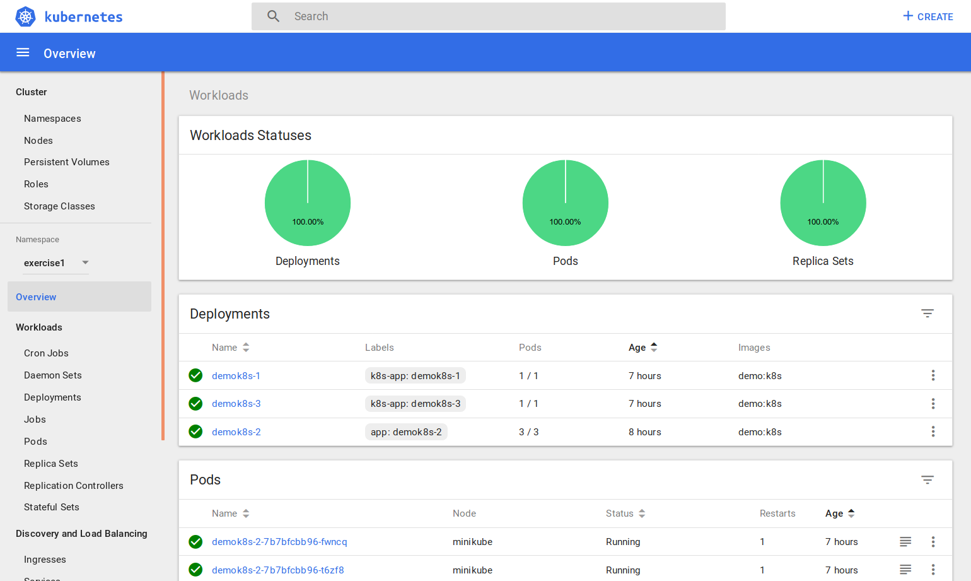
5. Lab Using KUbernetes
Kubernetes Dashboard
Graphical interface
CLI commands (kubectl ...)
Apply specifications files (yaml, json)

Slide 20
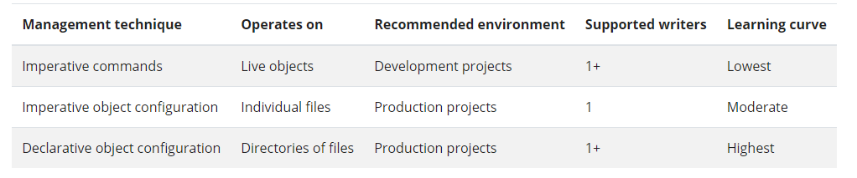
5. Lab Management approaches
Imperative commands:
kubectl create, expose, scale
Imperative objects:
kubectl create -f file.yml
Declarative objects:
kubectl apply -f dir/
kubectl delete -f dir/

Slide 21
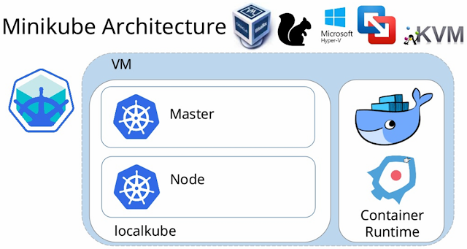
5. Lab Install Local cluster (minikube)
Go to the course repo and follow the instructions in ‘lab/readme.md’ to install kubernetes

Slide 22
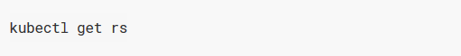
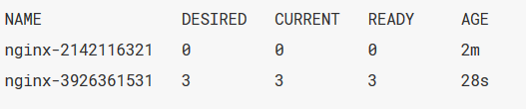
5. Lab Lab requirements
Windows
Install a Hypervisor
Oracle's Virtualbox: https://www.virtualbox.org/wiki/Downloads
Install Minikube
https://kubernetes.io/docs/tasks/tools/install-minikube
MacOS
Install a Hypervisor (skip if Docker already installed)
Install Minikube
https://kubernetes.io/docs/tasks/tools/install-minikube
Ubuntu
Install a Hypervisor
Oracle's Virtualbox: https://www.virtualbox.org/wiki/Downloads
Install Minikube
https://kubernetes.io/docs/tasks/tools/install-minikube

Slide 23
5. Lab exercise 1: Deploy Flask API demo
Go to the course repo and follow the instructions in ‘lab/exercise1/exercise1.md’

Slide 24
5. Lab exercise 2: Deploy message-app
Go to the course repo and follow the instructions in ‘lab/exercise2/exercise2.md’

Slide 25
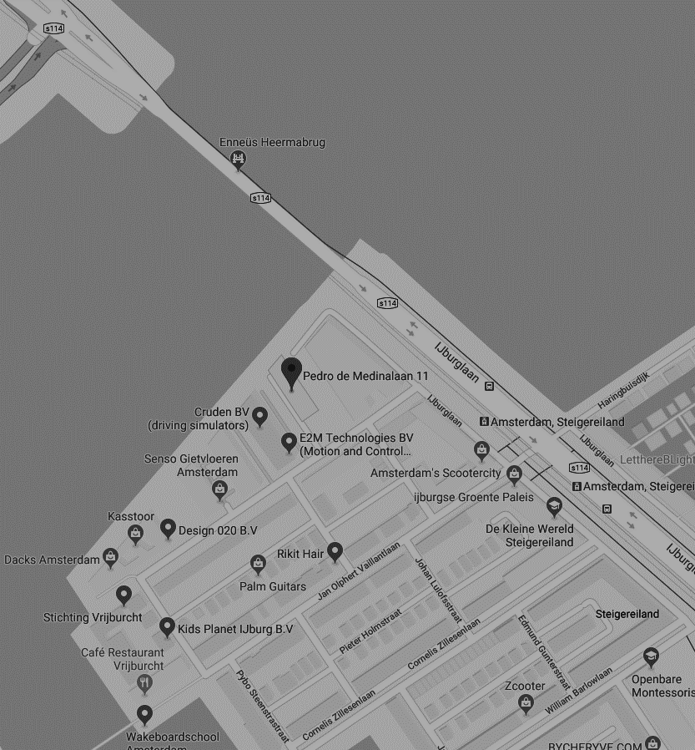
THANK YOU FOR YOUR ATTENTION
Pedro de Medinalaan 11, 1086 XK Amsterdam
020 - 773 1972
www.anchormen.nl

